Slide 1
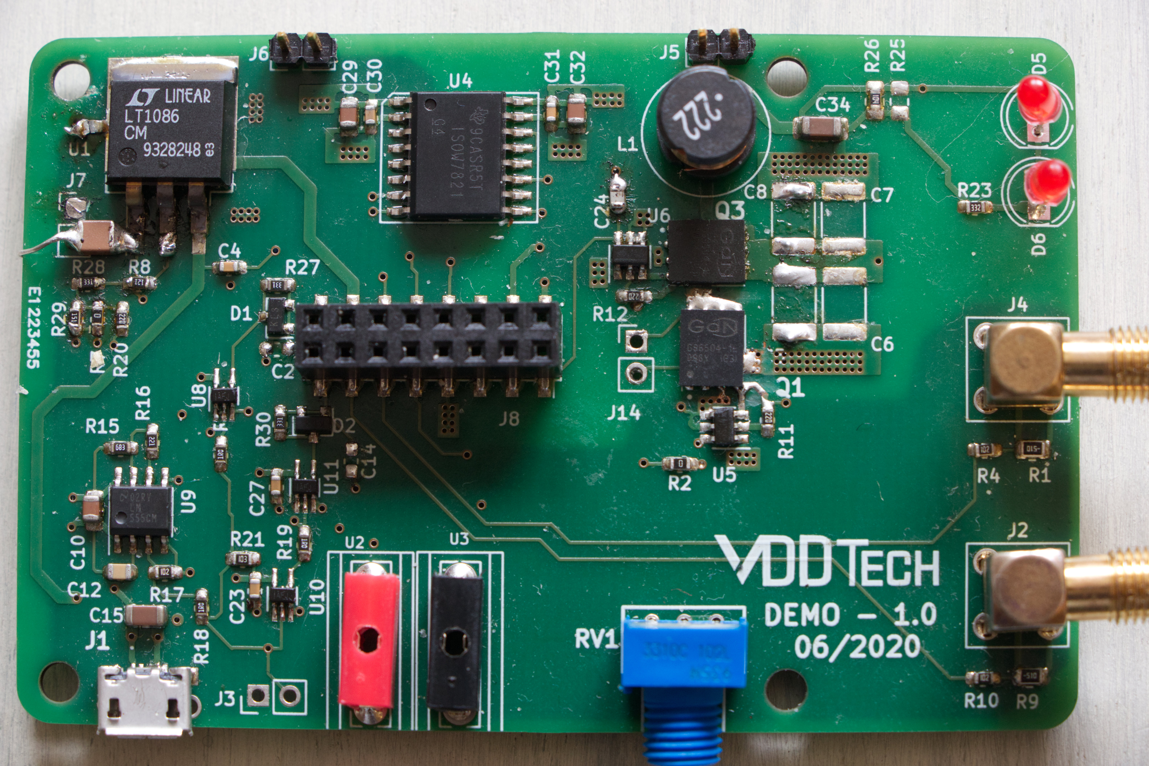
X
Larger inductor
SPI-CS-CTRL
Larger inductor
X
Scew
connector

